Slide 1
UNIT 6

Slide 2
Prerequisites
A system running Windows.
A working Internet connection.
Access to an account with administrator privileges.
Access to the command prompt.
A copy of Java installed and ready to use, with the JAVA_HOME environment variable set up (learn how to set up the JAVA_HOME environment variable in our guide to installing Java on Windows).

Slide 3
How to Install Maven on Windows
Follow the steps outlined below to install Apache Maven on Windows.
Step 1: Download Maven Zip File and Extract
1. Visit the Maven download page and download the version of Maven you want to install. The Files section contains the archives of the latest version. Access earlier versions using the archives link in the Previous Releases section.
2. Click on the appropriate link to download the binary zip archive of the latest version of Maven. As of the time of writing this tutorial, that is version 3.8.4.

Slide 4
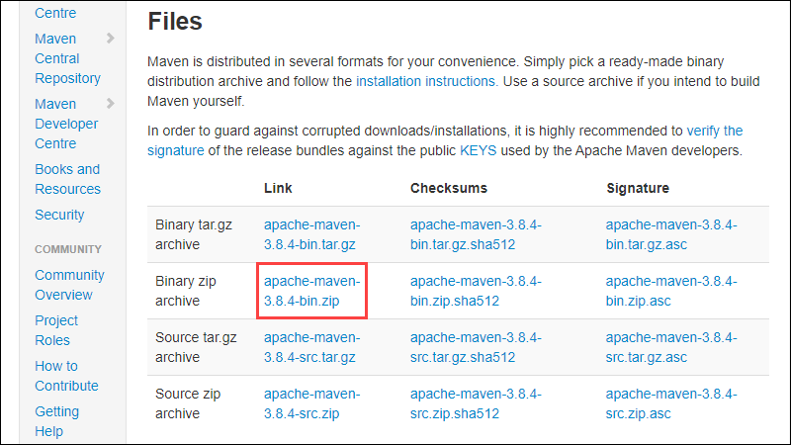

Slide 5
Since there is no installation process, extract the Maven archive to a directory of your choice once the download is complete. For this tutorial, we are using C:\Program Files\Maven\apache-maven-3.8.4.

Slide 6
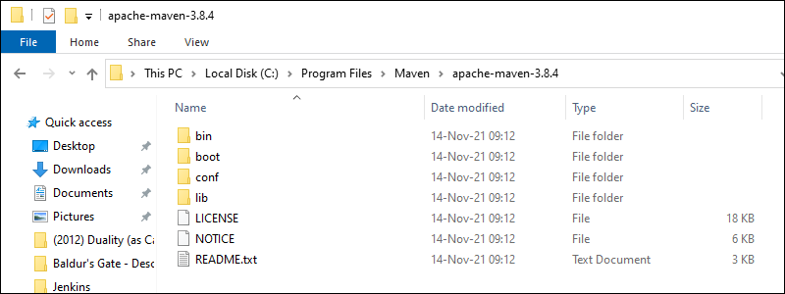

Slide 7
Step 2: Add MAVEN_HOME System Variable
1. Open the Start menu and search for environment variables.
2. Click the Edit the system environment variables result.

Slide 8
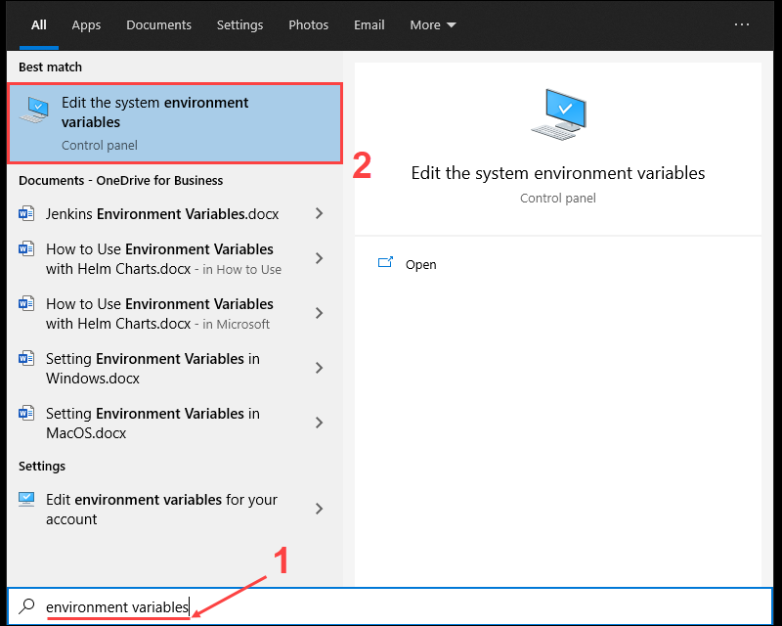

Slide 9
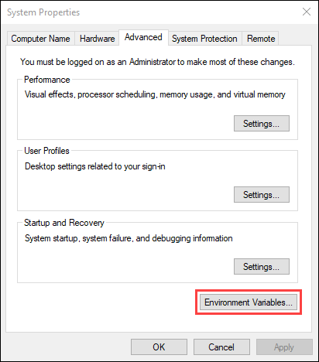

Slide 10
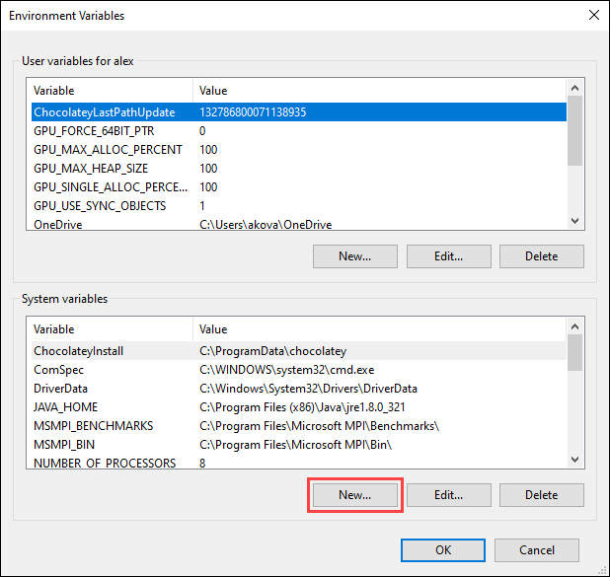

Slide 11
Enter MAVEN_HOME as the variable name and the path to the Maven directory as the variable value. Click OK to save the new system variable.

Slide 12
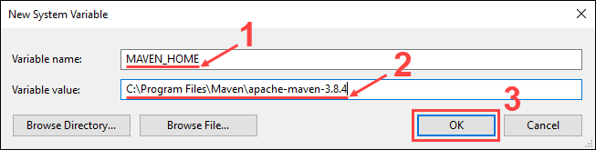

Slide 13
Step 3: Add MAVEN_HOME Directory in PATH Variable
1. Select the Path variable under the System variables section in the Environment Variables window. Click the Edit button to edit the variable.

Slide 14
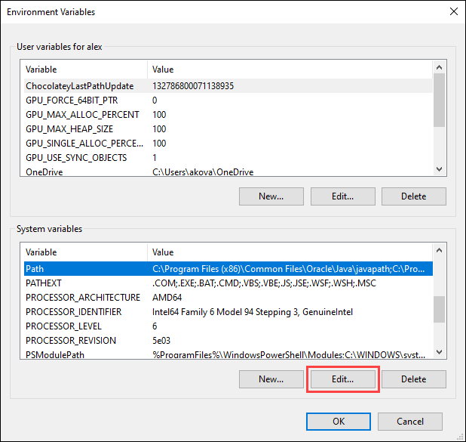

Slide 15
2. Click the New button in the Edit environment variable window.

Slide 16
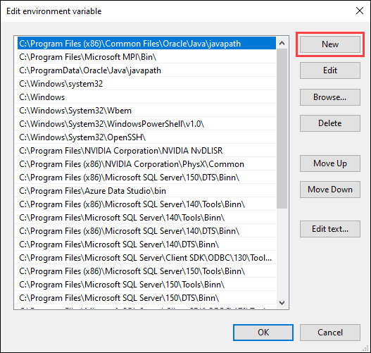

Slide 17
3. Enter %MAVEN_HOME%\bin in the new field. Click OK to save changes to the Path variable.

Slide 18
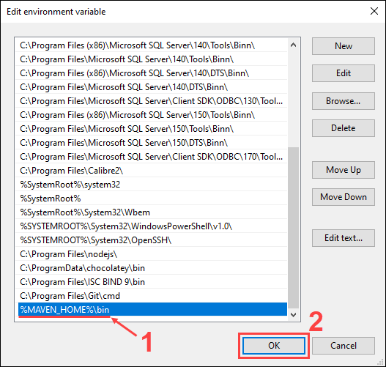

Slide 19
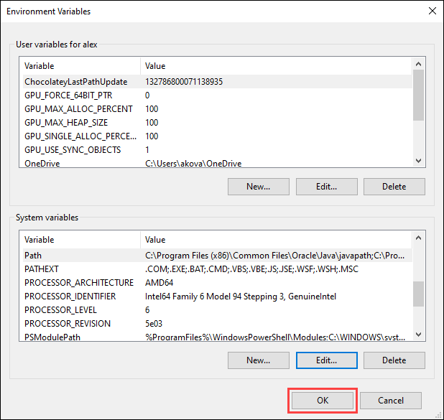
Click OK in the Environment Variables window to save the changes to the system variables.

Slide 20
Step 4: Verify Maven Installation
In the command prompt, use the following command to verify the installation by checking the current version of Maven:

Slide 21
mvn -version
mvn -version
Build Lifecycle Basics
Maven is based around the central concept of a build lifecycle. What this means is that the process for building and distributing a particular artifact (project) is clearly defined.
For the person building a project, this means that it is only necessary to learn a small set of commands to build any Maven project, and the POM will ensure they get the results they desired.
There are three built-in build lifecycles: default, clean and site. The default lifecycle handles your project deployment, the clean lifecycle handles project cleaning, while the site lifecycle handles the creation of your project's web site.

Slide 22
A Build Lifecycle is Made Up of Phases
Each of these build lifecycles is defined by a different list of build phases, wherein a build phase represents a stage in the lifecycle.
For example, the default lifecycle comprises of the following phases (for a complete list of the lifecycle phases, refer to the Lifecycle Reference):
validate - validate the project is correct and all necessary information is available
compile - compile the source code of the project
test - test the compiled source code using a suitable unit testing framework. These tests should not require the code be packaged or deployed
package - take the compiled code and package it in its distributable format, such as a JAR.
verify - run any checks on results of integration tests to ensure quality criteria are met
install - install the package into the local repository, for use as a dependency in other projects locally
deploy - done in the build environment, copies the final package to the remote repository for sharing with other developers and projects.
These lifecycle phases (plus the other lifecycle phases not shown here) are executed sequentially to complete the default lifecycle. Given the lifecycle phases above, this means that when the default lifecycle is used, Maven will first validate the project, then will try to compile the sources, run those against the tests, package the binaries (e.g. jar), run integration tests against that package, verify the integration tests, install the verified package to the local repository, then deploy the installed package to a remote repository.

Slide 23
Usual Command Line Calls
You should select the phase that matches your outcome. If you want your jar, run package. If you want to run the unit tests, run test.
If you are uncertain what you want, the preferred phase to call is

Slide 24
mvn verify
This command executes each default lifecycle phase in order (validate, compile, package, etc.), before executing verify. You only need to call the last build phase to be executed, in this case, verify. In most cases the effect is the same as package. However, in case there are integration-tests, these will be executed as well. And during the verify phase some additional checks can be done, e.g. if your code written according to the predefined checkstyle rules.
In a build environment, use the following call to cleanly build and deploy artifacts into the shared repository.

Slide 25
Maven Lifecycle and Basic Maven Commands

Slide 26
Maven is a powerful project management tool that is based on POM (project object model), used for project build, dependency, and documentation. It is a tool that can be used for building and managing any Java-based project. Maven makes the day-to-day work of Java developers easier and helps with the building and running of any Java-based project.
For more details on how Maven works, how to install Maven and its applications, please visit: Introduction to Apache Maven
Maven Lifecycle: Below is a representation of the default Maven lifecycle and its 8 steps: Validate, Compile, Test, Package, Integration test, Verify, Install, and Deploy.

Slide 27
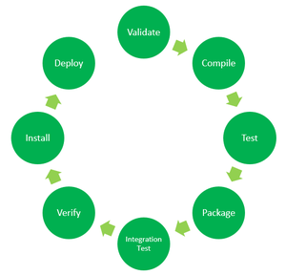

Slide 28
Validate: This step validates if the project structure is correct. For example – It checks if all the dependencies have been downloaded and are available in the local repository.
Compile: It compiles the source code, converts the .java files to .class, and stores the classes in the target/classes folder.
Test: It runs unit tests for the project.
Package: This step packages the compiled code in a distributable format like JAR or WAR.
Integration test: It runs the integration tests for the project.
Verify: This step runs checks to verify that the project is valid and meets the quality standards.
Install: This step installs the packaged code to the local Maven repository.
Deploy: It copies the packaged code to the remote repository for sharing it with other developers.

Slide 29
Maven follows a sequential order to execute the commands where if you run step n, all steps preceding it (Step 1 to n-1) are also executed. For example – if we run the Installation step (Step 7), it will validate, compile, package and verify the project along with running unit and integration tests (Step 1 to 6) before installing the built package to the local repository.

Slide 30
Maven Commands:
mvn clean: Cleans the project and removes all files generated by the previous build.
mvn compile: Compiles source code of the project.
mvn test-compile: Compiles the test source code.
mvn test: Runs tests for the project.
mvn package: Creates JAR or WAR file for the project to convert it into a distributable format.
mvn install: Deploys the packaged JAR/ WAR file to the local repository.
mvn site: generate the project documentation.
mvn validate: validate the project’s POM and configuration.
mvn idea:idea: generate project files for IntelliJ IDEA or Eclipse.
mvn release:perform: Performs a release build.
mvn deploy: Copies the packaged JAR/ WAR file to the remote repository after compiling, running tests and building the project.
mvn archetype:generate: This command is used to generate a new project from an archetype, which is a template for a project. This command is typically used to create new projects based on a specific pattern or structure.
mvn dependency:tree: This command is used to display the dependencies of the project in a tree format. This command is typically used to understand the dependencies of the project and troubleshoot any issues.

Slide 31
Generally when we run any of the above commands, we add the mvn clean step so that the target folder generated from the previous build is removed before running a newer build. This is how the command would look on integrating the clean step with install phase:
mvn clean install

Slide 32
Similarly, if we want to run the step in debug mode for more detailed build information and logs, we will add -X to the actual command. Hence, the install step with debug mode on will have the following command:
mvn -X install

Slide 33
Consider a scenario where we do not want to run the tests while packaging or installing the Java project. In this case, we use -DskipTests along with the actual command. If we need to run the install step by skipping the tests associated with the project, the command would be:
mvn install -DskipTests

Slide 34
Maven pom.xml file
POM is an acronym for Project Object Model. The pom.xml file contains information of project and configuration information for the maven to build the project such as dependencies, build directory, source directory, test source directory, plugin, goals etc.
Maven reads the pom.xml file, then executes the goal.
Before maven 2, it was named as project.xml file. But, since maven 2 (also in maven 3), it is renamed as pom.xml.

Slide 35
Element | Description
project | It is the root element of pom.xml file.
modelVersion | It is the sub element of project. It specifies the modelVersion. It should be set to 4.0.0.
groupId | It is the sub element of project. It specifies the id for the project group.
artifactId | It is the sub element of project. It specifies the id for the artifact (project). An artifact is something that is either produced or used by a project. Examples of artifacts produced by Maven for a project include: JARs, source and binary distributions, and WARs.
version | It is the sub element of project. It specifies the version of the artifact under given group.

Slide 36
Element | Description
packaging | defines packaging type such as jar, war etc.
name | defines name of the maven project.
url | defines url of the project.
dependencies | defines dependencies for this project.
dependency | defines a dependency. It is used inside dependencies.
scope | defines scope for this maven project. It can be compile, provided, runtime, test and system.
Maven pom.xml file with additional elements
Here, we are going to add other elements in pom.xml file such as:

Slide 37
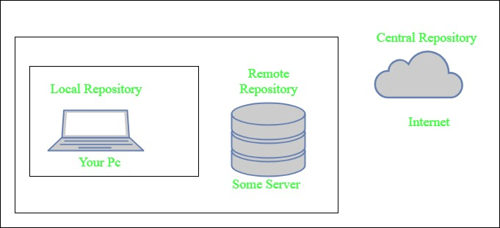

Slide 38
What Is Maven Architecture?
Maven repository is a place where the maven artefacts or dependencies of the JAR file is going to store which are written in the file called the POM.XML. POM.XML contains the Java classes, resources, and other dependencies.There are the two types of repositories like

Slide 39
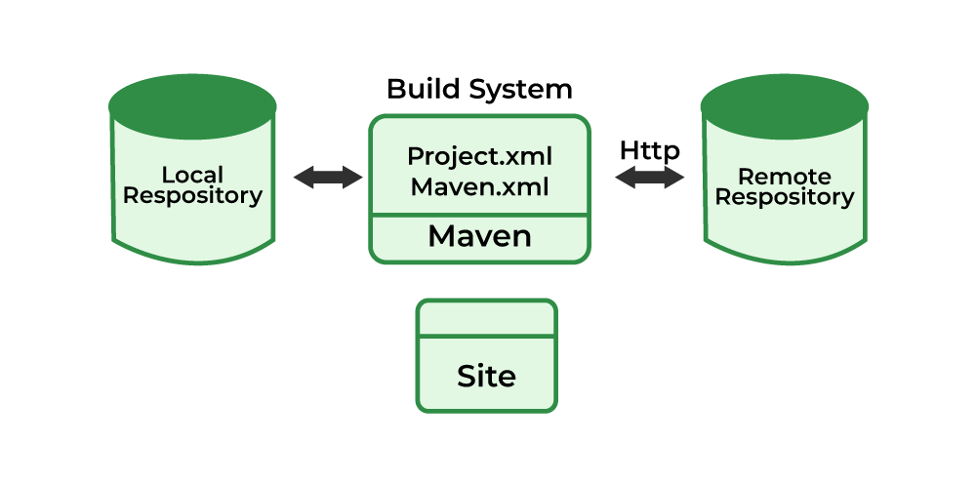

Slide 40
Maven can be used for the following:
We can easily build a project using maven.
We can add jars and other dependencies of the project easily using the help of maven.
Maven provides project information (log document, dependency list, unit test reports, etc.)
Maven is very helpful for a project while updating the central repository of JARs and other dependencies.
With the help of Maven, we can build any number of projects into output types like the JAR, WAR, etc without doing any scripting.
Using maven we can easily integrate our project with a source control systems (such as Subversion or Git).
Maven also helps in managing the project’s build lifecycle, including tasks like compiling, testing, packaging, and deploying the code.
Maven provides a standard project structure, making it easy for developers to understand the layout of the project and locate specific files.
Maven supports multi-module projects, allowing developers to work on multiple related projects simultaneously and manage their dependencies efficiently.
Maven plugins can be used to add additional functionality to the build process, such as code coverage analysis, static code analysis, and more.
Maven is highly customizable, allowing developers to configure the build process to meet their specific needs and requirements.
Maven simplifies the process of managing project dependencies, ensuring that the correct versions of libraries and frameworks are used throughout the project.

Slide 41
What Is Maven pom.xml File
POM means Project Object Model is key to operate Maven. Maven reads pom.xml file to accomplish its configuration and operations. It is an XML file that contains information related to the project and configuration information such as dependencies, source directory, plugin, goals etc. used by Maven to build the project

Slide 42
Elements used for Creating pom.xml file
project- It is the root element of the pom.xml file.
modelVersion- modelversion means what version of the POM model you are using. Use version 4.0.0 for maven 2 and maven 3.
groupId- groupId means the id for the project group. It is unique and Most often you will use a group ID which is similar to the root Java package name of the project like we used the groupId com.project.loggerapi.
artifactId- artifactId used to give name of the project you are building.in our example name of our project is LoggerApi.
version- version element contains the version number of the project. If your project has been released in different versions then it is useful to give version of your project.

Slide 43
What is Pom.xml file Key Components
dependencies- dependencies element is used to defines a list of dependency of project.
dependency- dependency defines a dependency and used inside dependencies tag. Each dependency is described by its groupId, artifactId and version.
name- this element is used to give name to our maven project.
scope- this element used to define scope for this maven project that can be compile, runtime, test, provided system etc.
packaging- packaging element is used to packaging our project to output types like JAR, WAR etc.

Slide 44
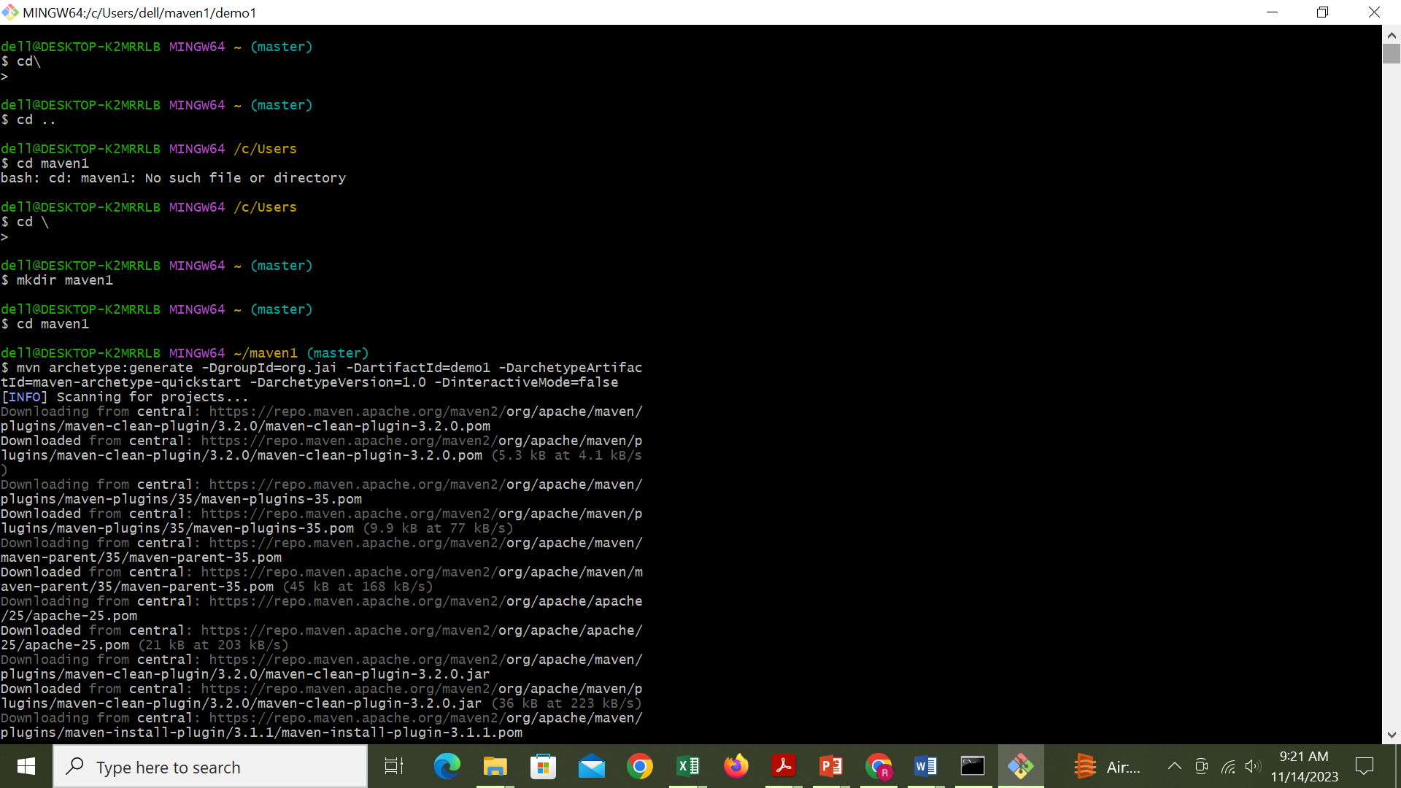

Slide 45
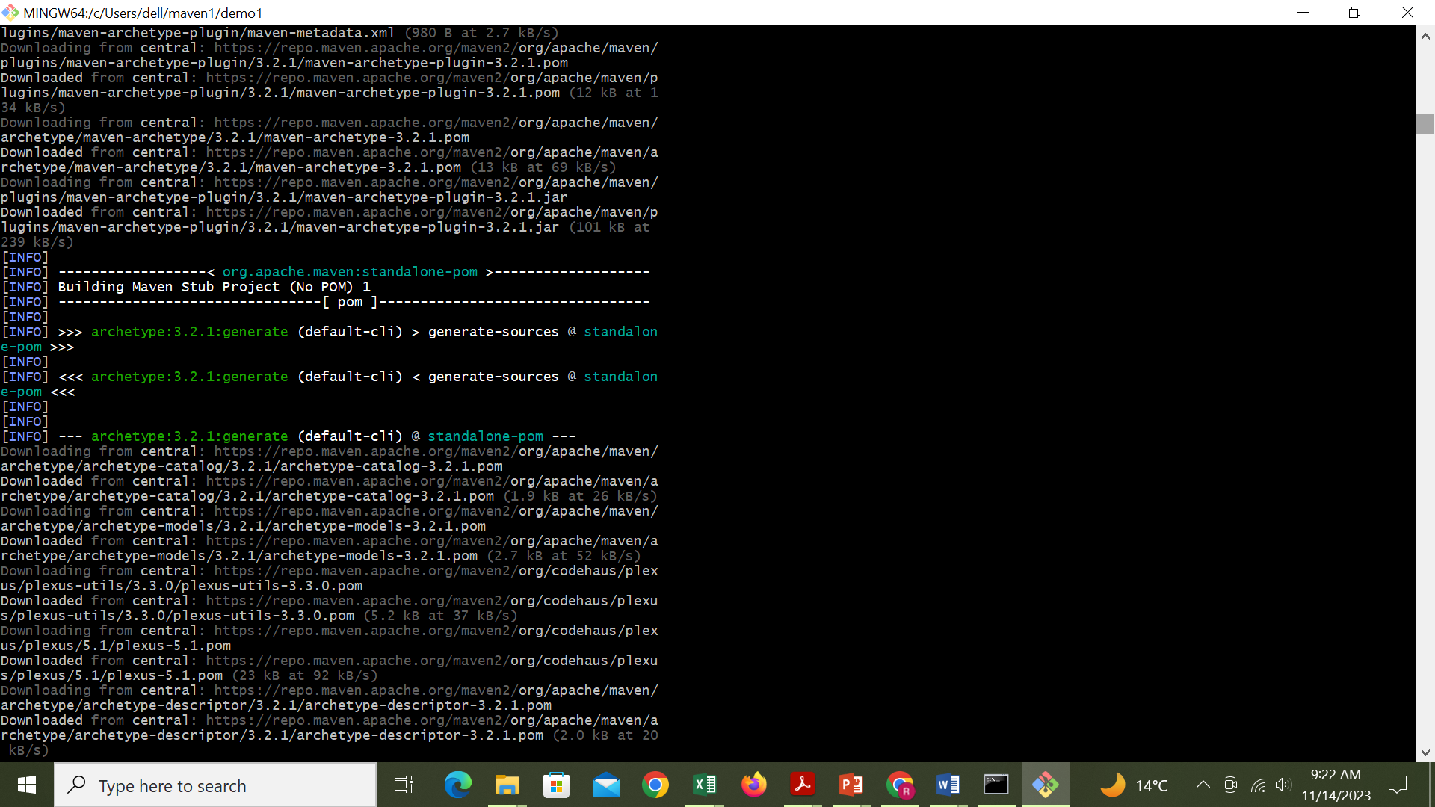

Slide 46
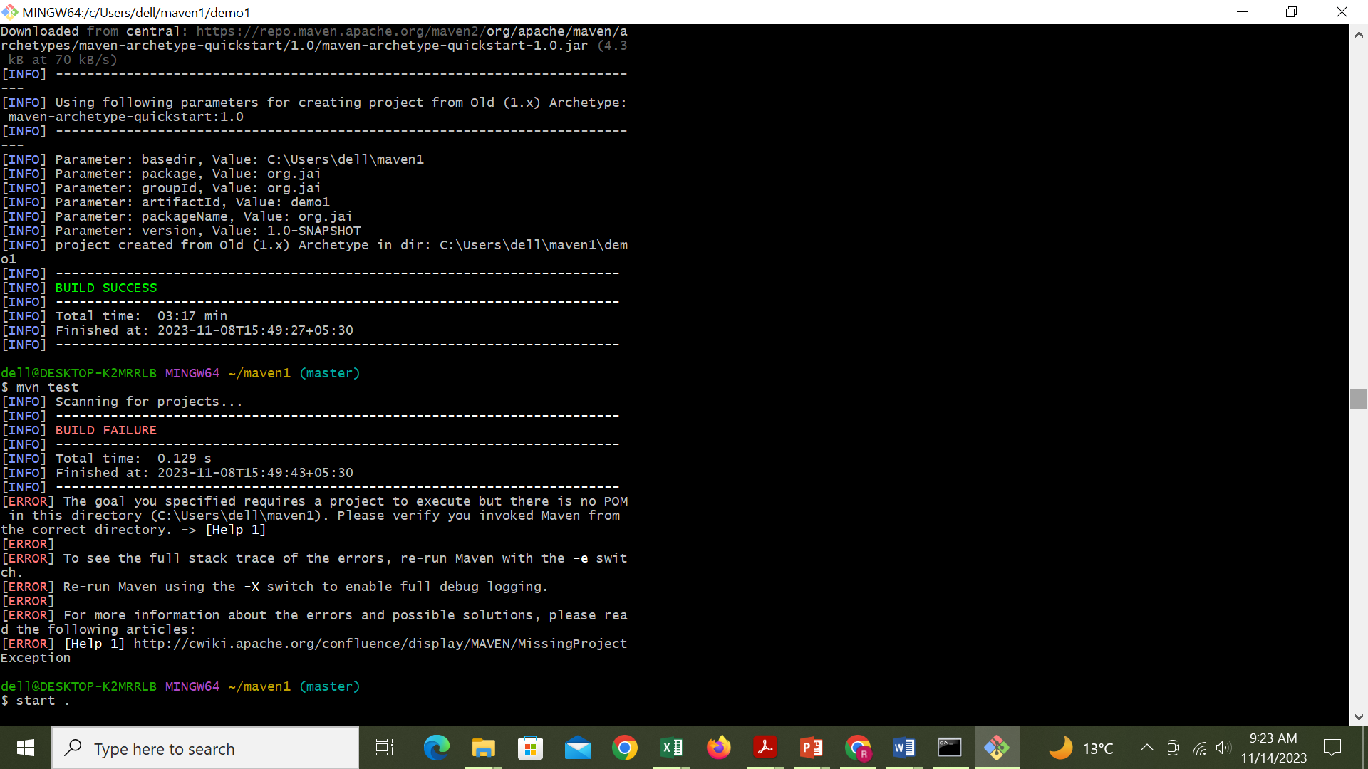

Slide 47
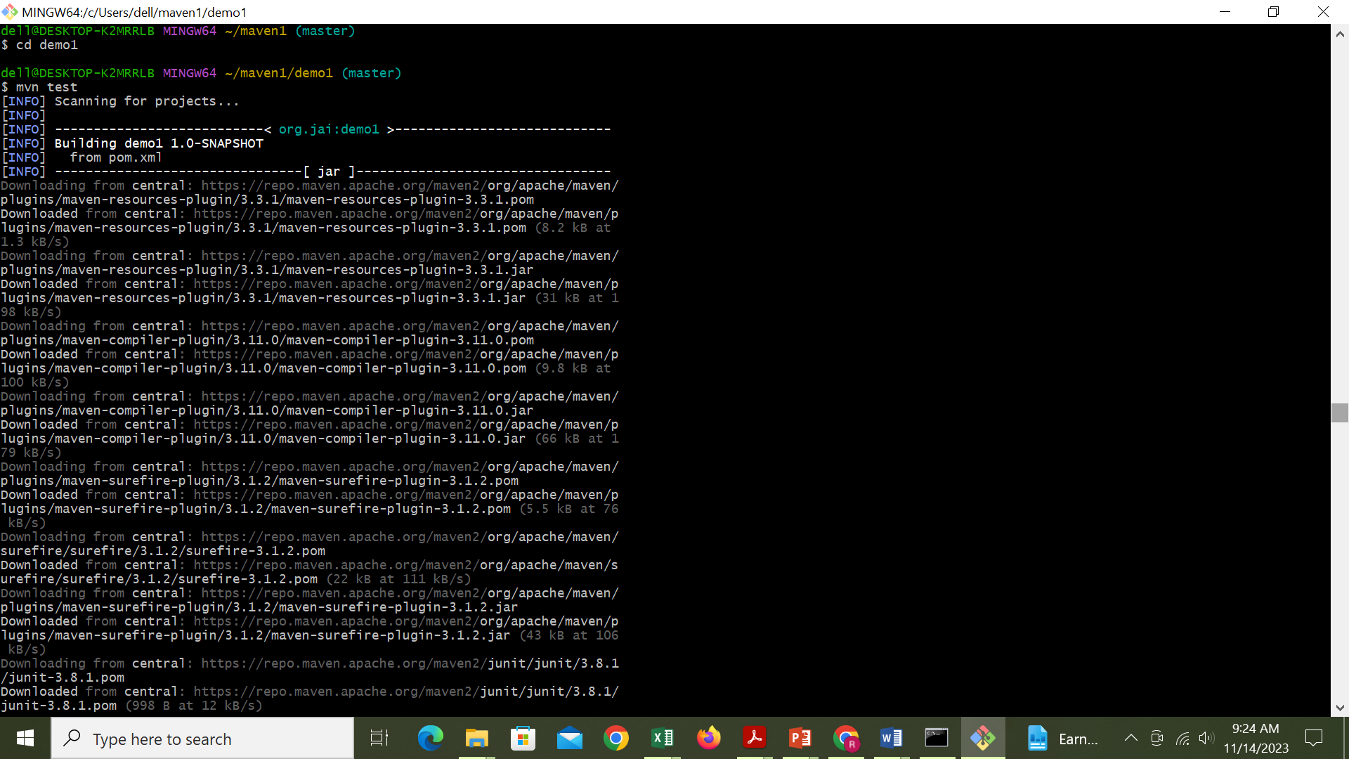

Slide 48
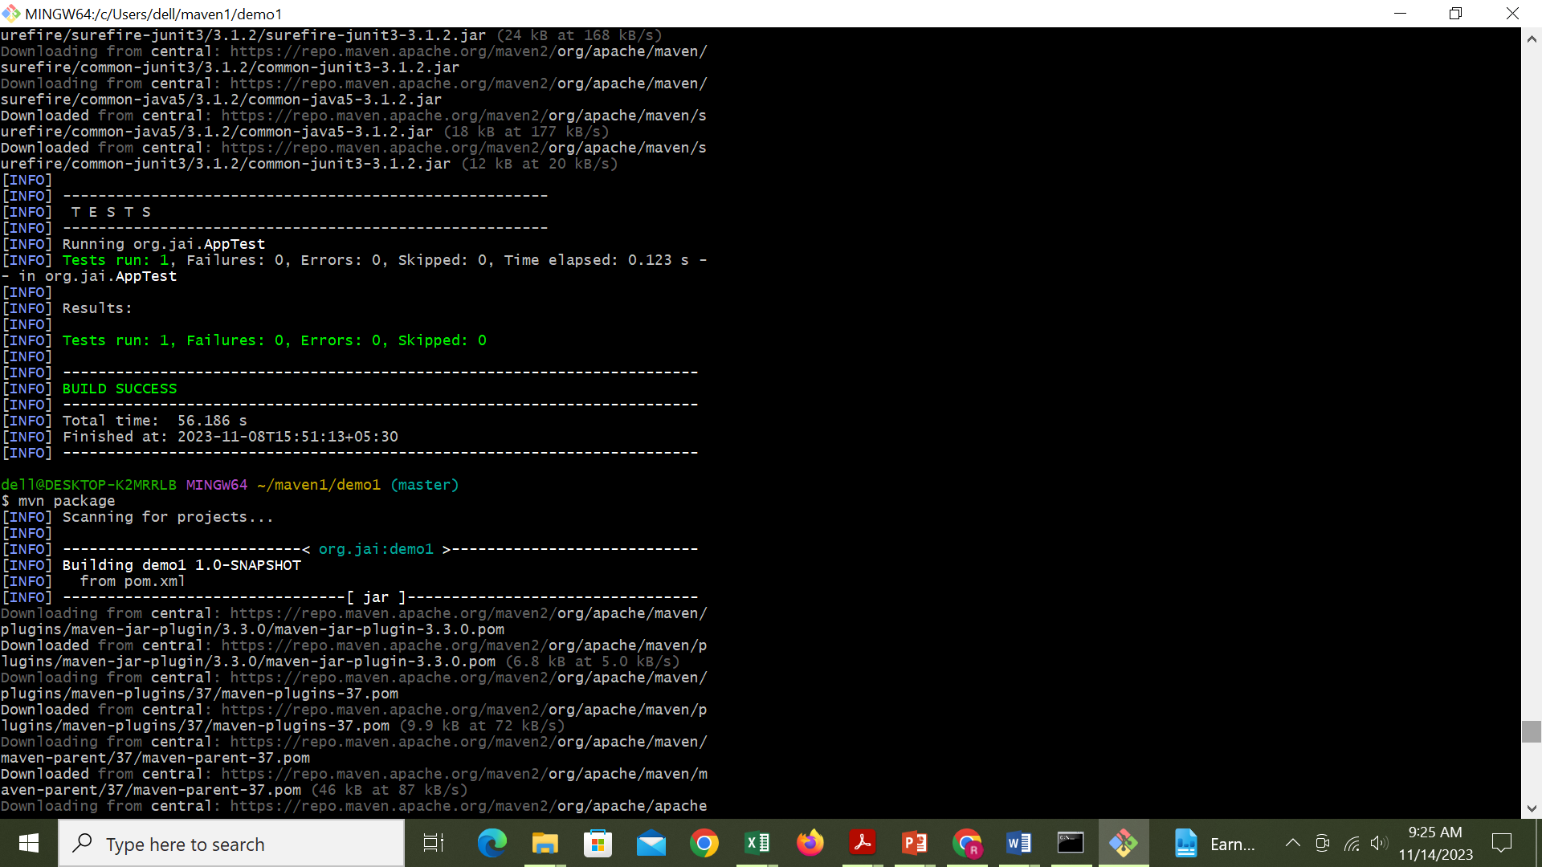

Slide 49
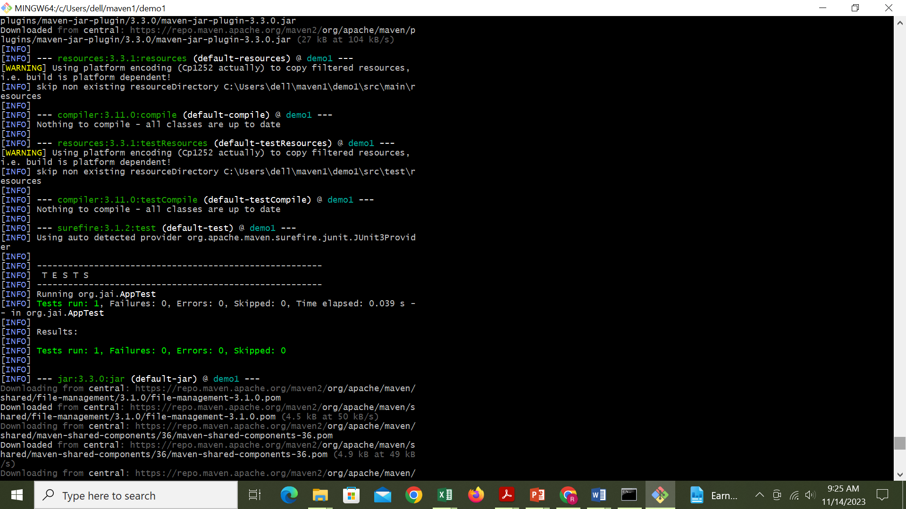

Slide 50
